Slide 1
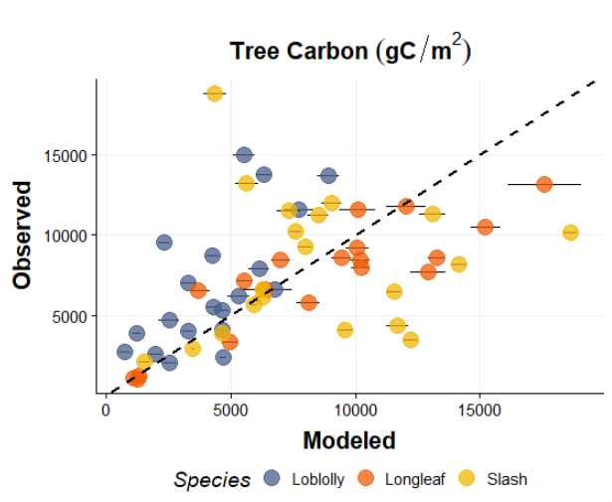
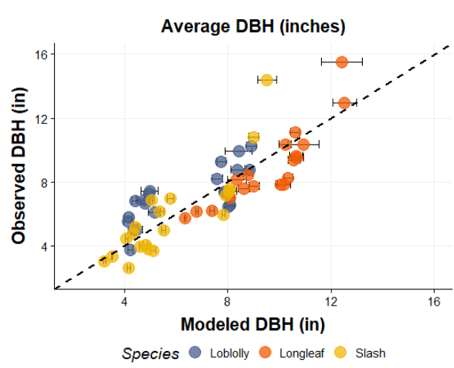
Original mortalities without Longleaf outlier
Multiple R-squared: 0.2241, Adjusted R-squared: 0.2105
Multiple R-squared: 0.7074, Adjusted R-squared: 0.7023

Slide 2
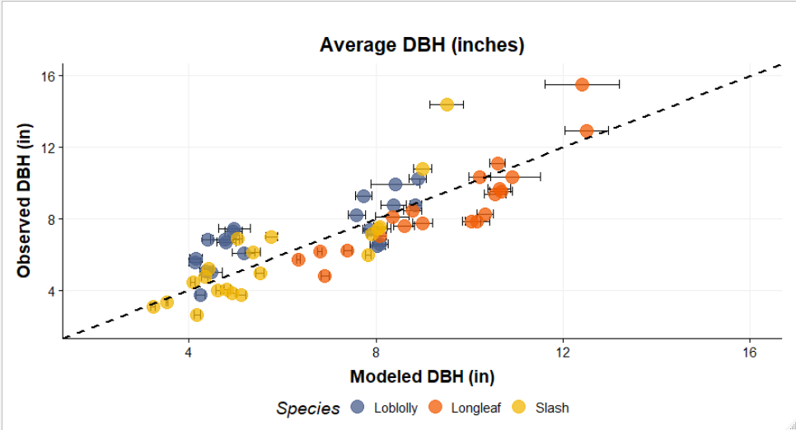
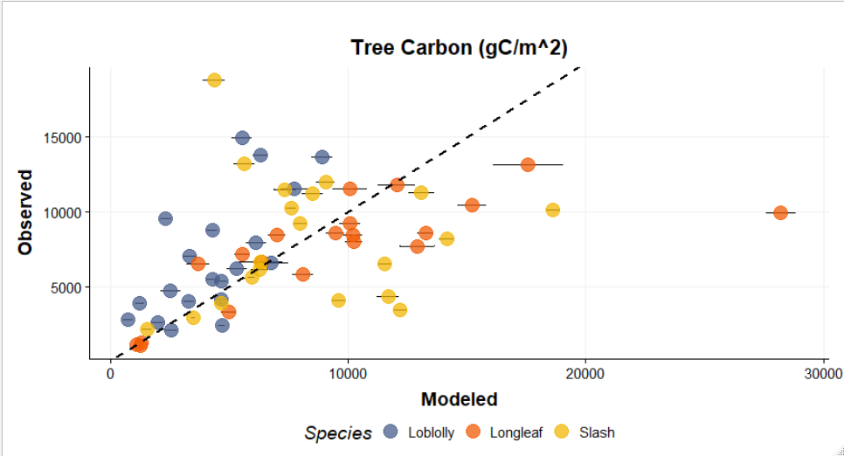
Original mortalities
Adjusted R-squared: 0.6945 or
0.7023 without outlier
Adjusted R-squared: 0.1807 or 0.2105 without outlier

Slide 3
Slash pine
Seeing if decreasing intervals for mortality helps
I used the mortality curve from same paper (neg exponential, but with more points along the curve)

Slide 4
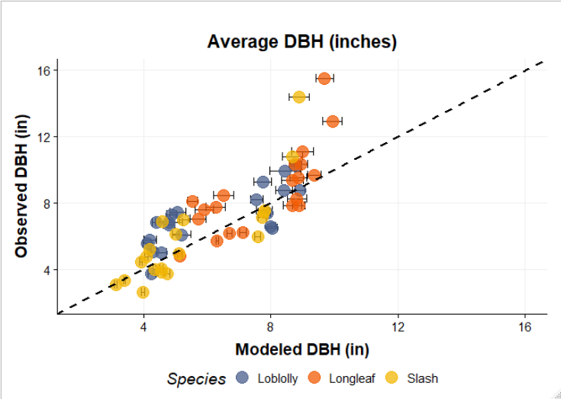
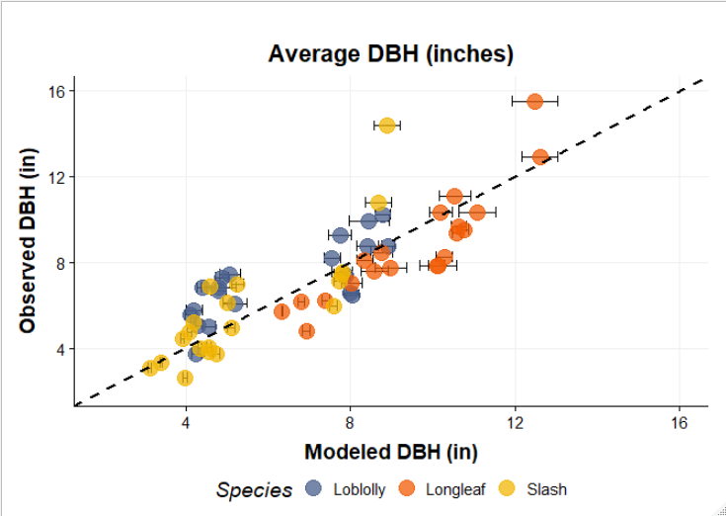
Left is with new longleaf mortality and new slash pine mortality right is old longleaf mortality and new slash pine mortality
Adjusted R-squared: 0.6711
Adjusted R-squared: 0.6859

Slide 5
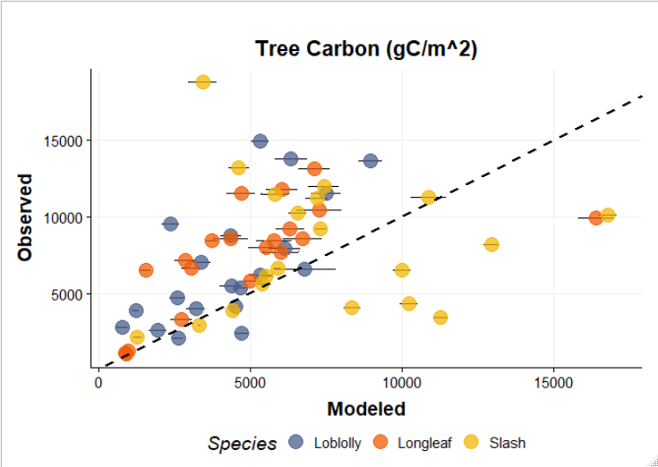
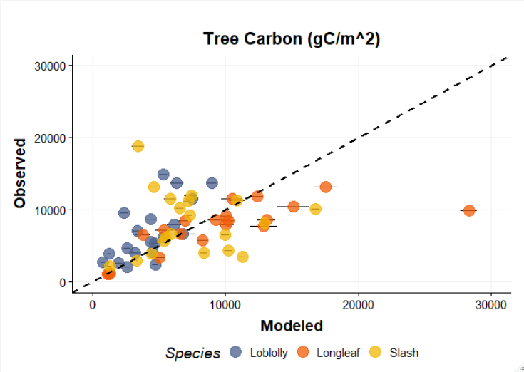
Left is with new longleaf mortality and new slash pine mortality right is old longleaf mortality and new slash pine mortality
Adjusted R-squared: 0.139
Adjusted R-squared: 0.166 or 0.1978 if outlier is excluded

Slide 6
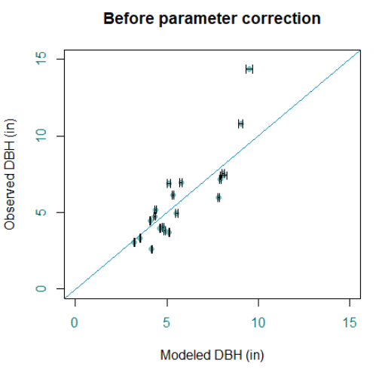
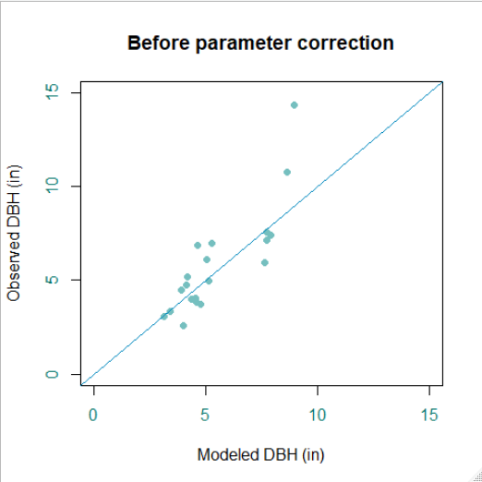
Left is old mortality by diameter (from histogram) Right is new, steeper mortality curve.

Slide 7
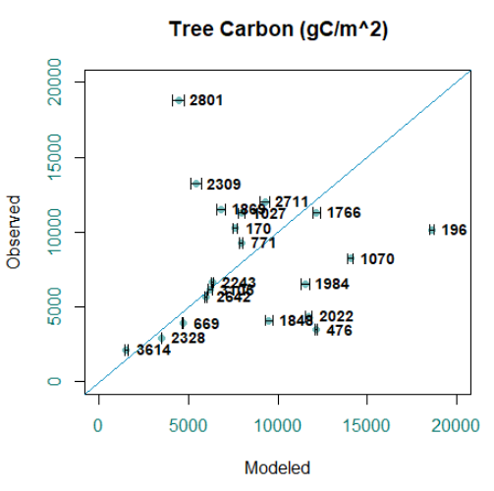
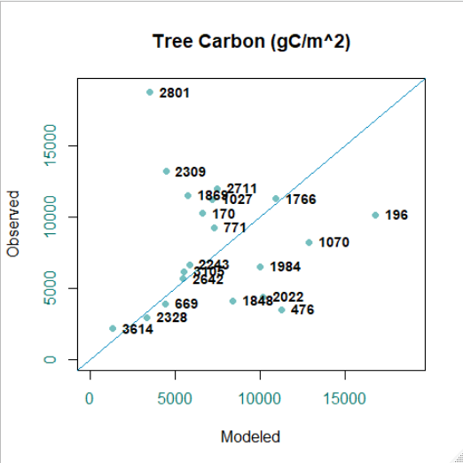
Left is old mortality by diameter (from histogram) Right is new, steeper mortality curve.

Slide 8
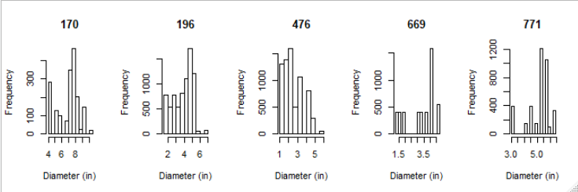
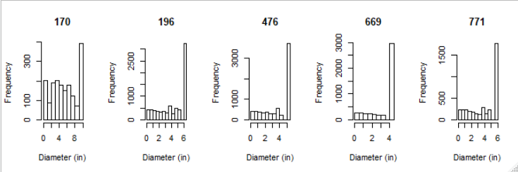
Observed vs modeled diameter distributions
Observed
Modeled

Slide 9
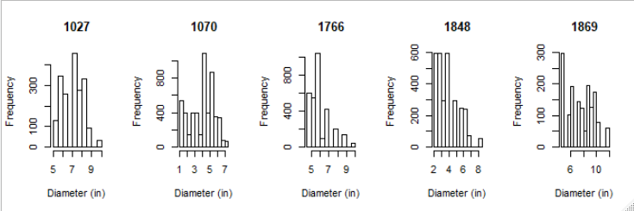
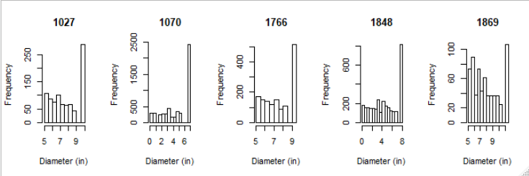
Observed vs modeled diameter distributions
Observed
Modeled

Slide 10
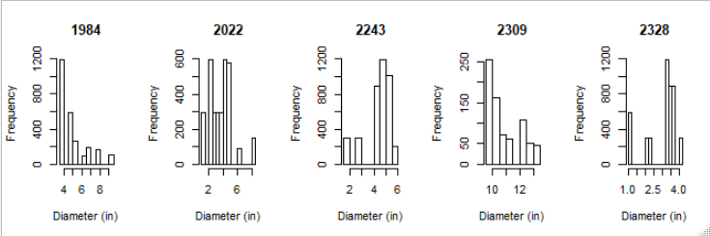
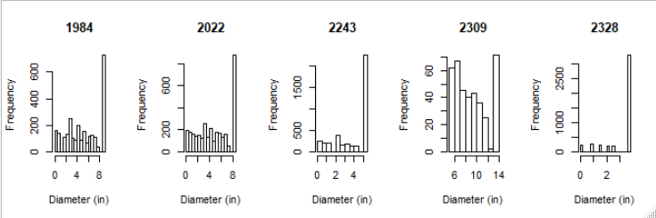
Observed vs modeled diameter distributions
Observed
Modeled

Slide 11
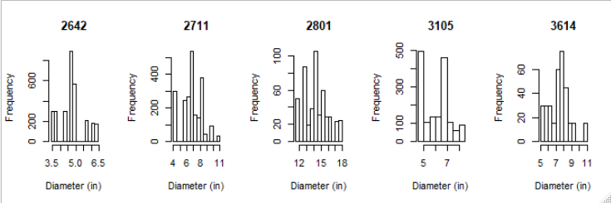
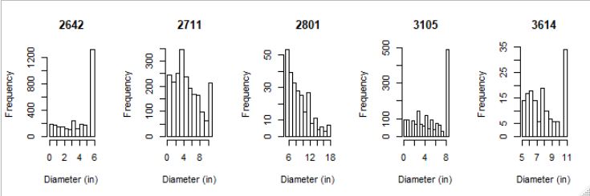
Observed vs modeled diameter distributions
Observed
Modeled

Slide 12
Longleaf
Figuring out mortality (simulations run for 80 years do not show characteristic decreasing frequency with increasing size class)
I used new mortality from Platt 1988 (U-shaped, but with steeper curve)

Slide 13
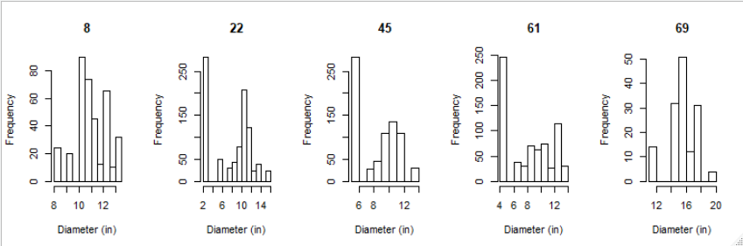
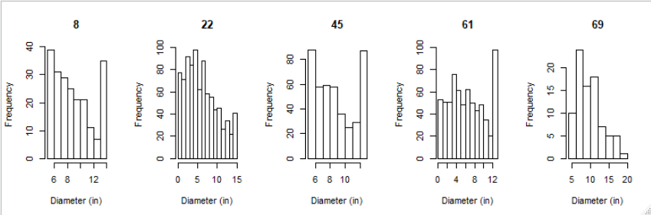
Observed vs modeled diameter distributions
Observed
Modeled

Slide 14
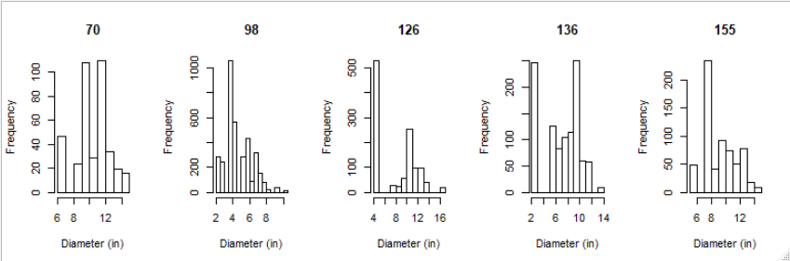
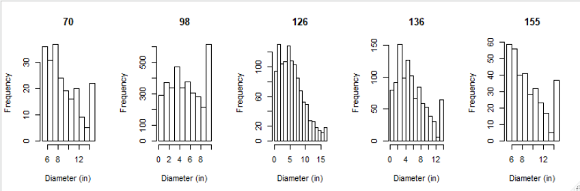
Observed vs modeled diameter distributions

Slide 15
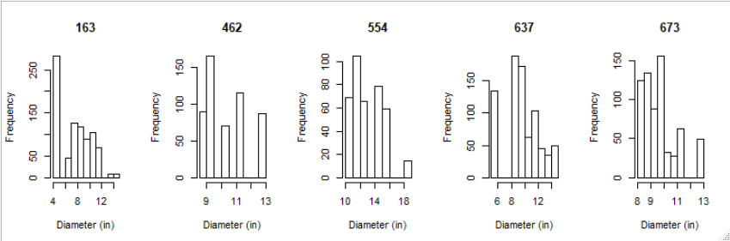
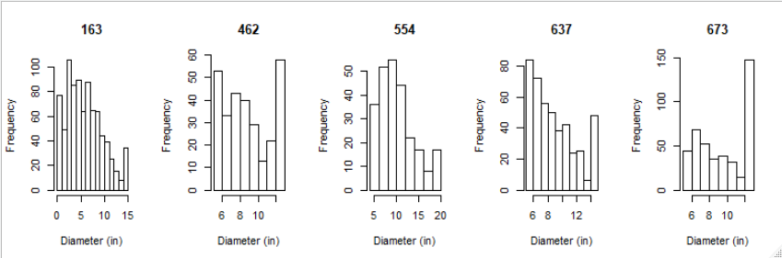
Observed vs modeled diameter distributions

Slide 16
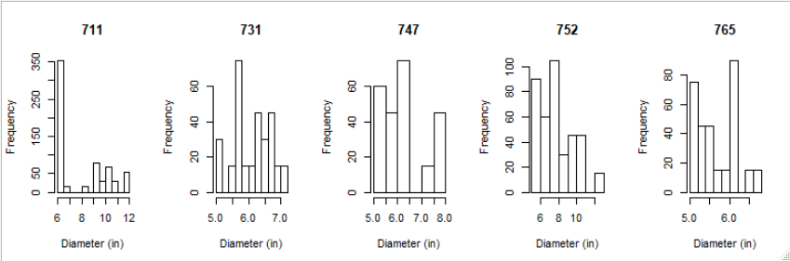
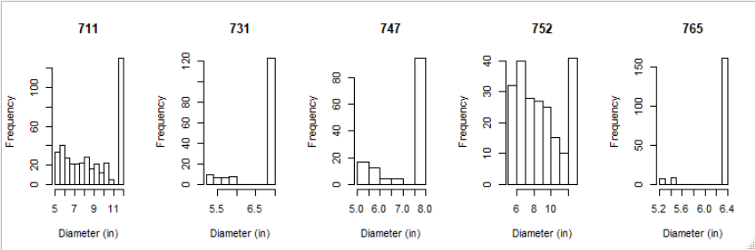
Observed vs modeled diameter distributions

Slide 17
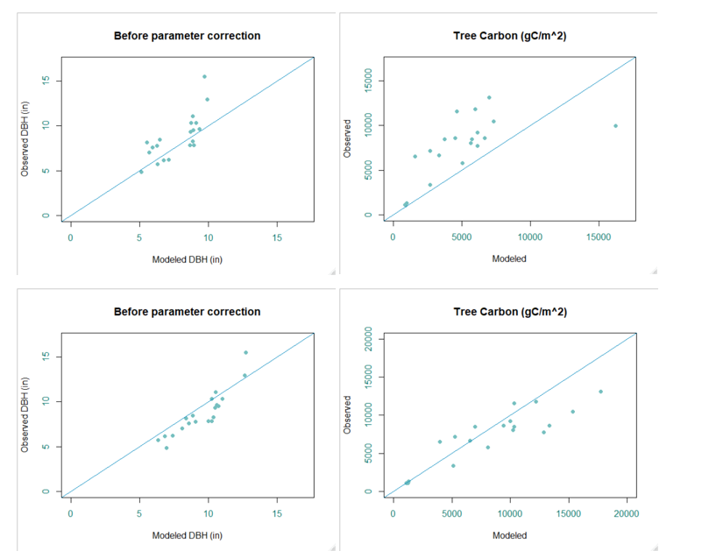
Top is new, steeper mortality curve (Platt 1988). Bottom is old mortality curve

Slide 18
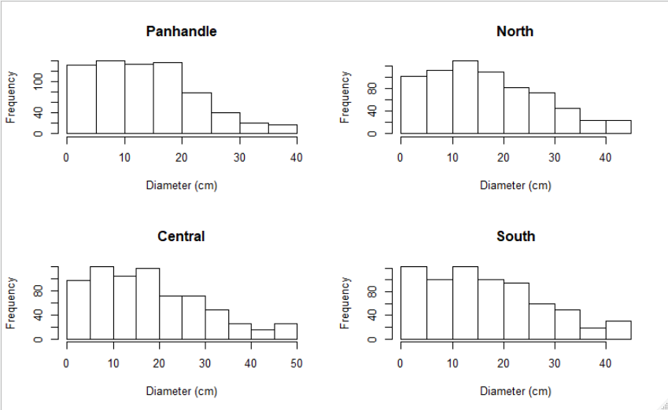
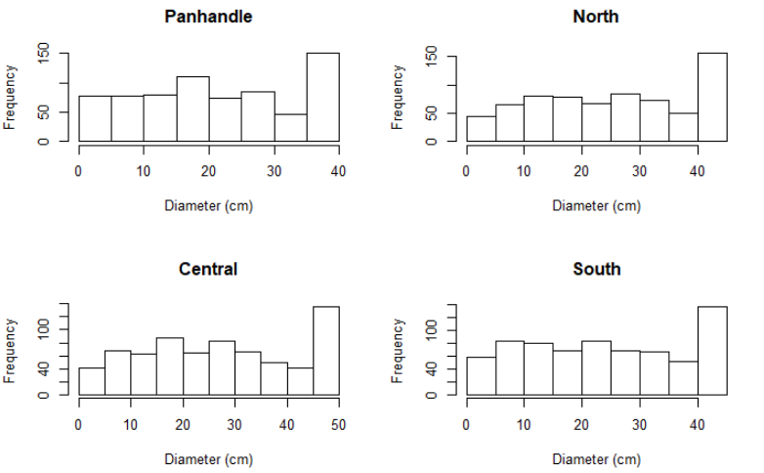
Left is 700tph simulated for 80 years using new mortality compared to old mortality (right)

Slide 19
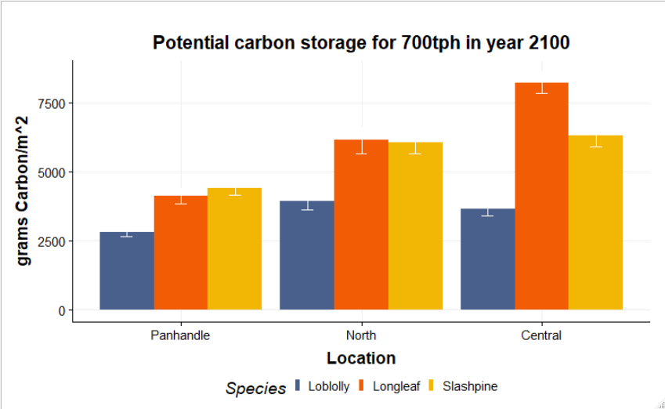
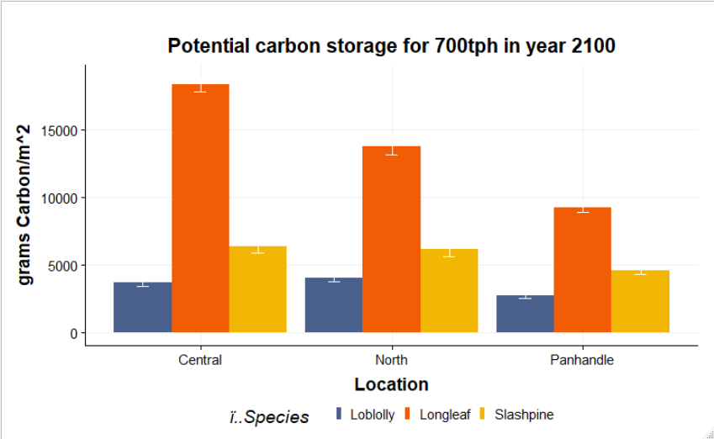
Graph on left is with new longleaf mortality

